Slide 1


Slide 2

Department of Computer Engineering
Project Title : Hybrid Energy inspired DC Micro-grid System using Machine Learning
Project Group ID/ Group details : 4
Project Guide : Dr. B. S. Tarle
Project Group Members :
1. Name: Sakshi Jadhav Seat No: B190294222
2. Name: Samruddhi Khairnar Seat No: B190294231
3. Name: Kunika Narnaware Seat No: B190294239
4. Name: Pranjal Shewale Seat No: B190294262

Slide 3
PROBLEM STATEMENT
Traditional power plants make use of the manual power demand and generation matching processes, causing time delays and wastage of electric power generated in excess, which is usually grounded.
Hence, a smart power plant management system is necessary, to minimize the wastage of electricity by controlling the power generation. Power from various energy sources can be integrated, in the form of a hybrid power plant, according to the observed power demand of the users.

Slide 4
TOOLS AND TECHNOLOGIES
Tools :
• Illumination Sensor: For capturing sunlight readings.
• Temperature and Humidity Sensor: For capturing weather data.
• Voltage and Current Sensors: For capturing load demand readings.
• Relays: For managing power flow between different sources.
• Raspberry Pi: For aggregating sensor readings.
Technologies :
• AWS EC2: For running virtual machines and processing data.
• Apache Kafka: For data streaming and real-time data pipelines.
• Python: For scripting and implementing machine learning models.
• TensorFlow: For training deep learning models.
• Keras: Framework for quick model development on top of Tensorflow.

Slide 5
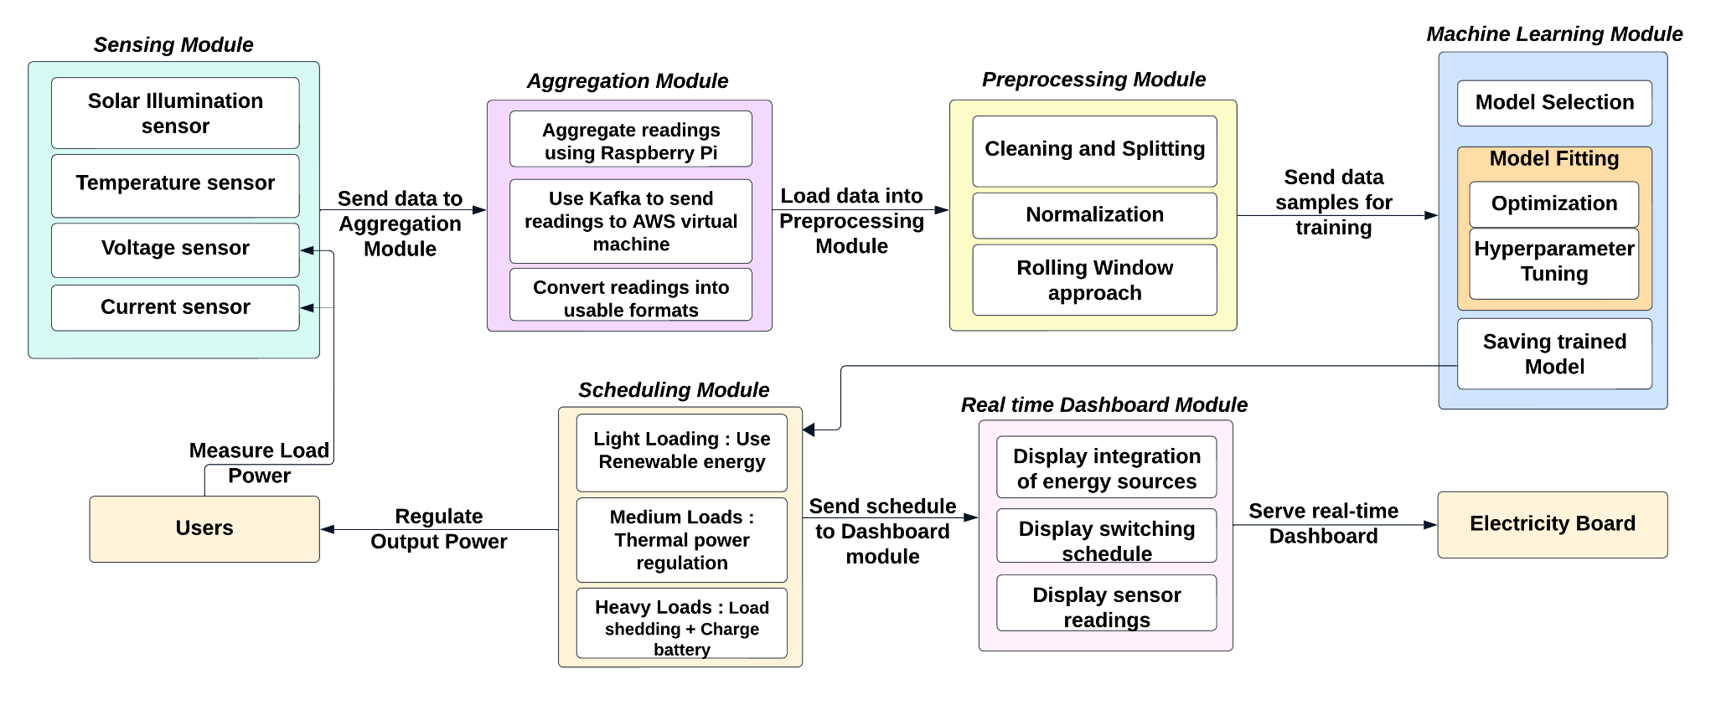
SYSTEM ARCHITECTURE

Slide 6
IMPLEMENTATION
The proposed system can be deployed in Hybrid power plants, to automate the power generation in real-time, as per the estimated load demand.
1. Sensing Module:
(a) An illumination sensor: for sunlight readings.
(b) A temperature and humidity sensor: weather data.
(c) A combination of voltage and current sensors, to obtain load demand readings.
2. Aggregation Module: Aggregation of sensor readings using a Raspberry Pi, sending them to a virtual machine running on the AWS Cloud using Apache Kafka.

Slide 7
IMPLEMENTATION
3. Preprocessing Module: Cleaning and normalization of the aggregated data; applying a rolling window.
4. Machine Learning Module: Fitting an LSTM model to the dataset, tuning its hyperparameters, validating its accuracy using the MSE metric, saving the model.
5. Power Scheduling Module: Switches the power sources’ line connections at the users’ end so each user gets connected to either the solar or conventional source.
6. Dashboard Module: Displays actual vs estimated power generation.

Slide 8
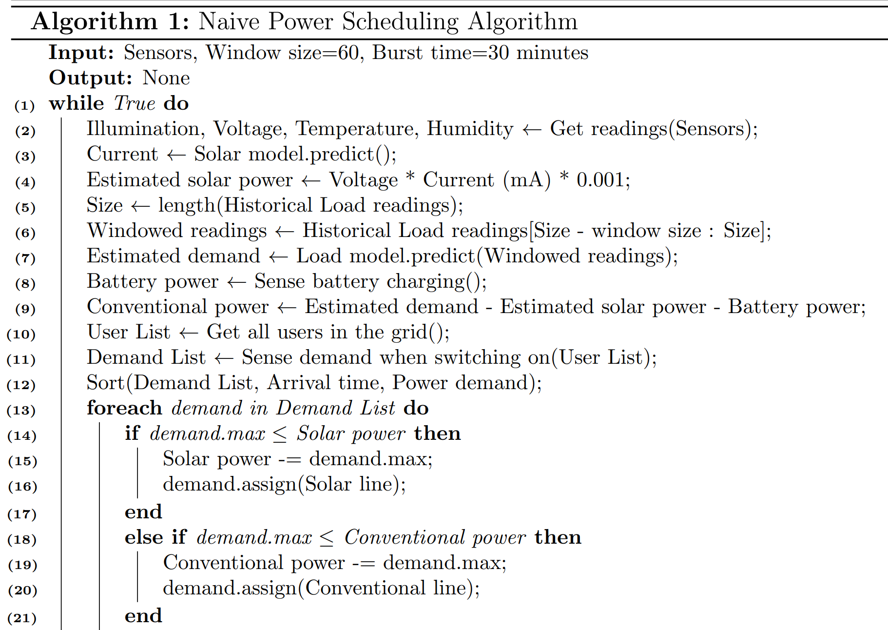
POWER SCHEDULING ALGORITHM

Slide 9
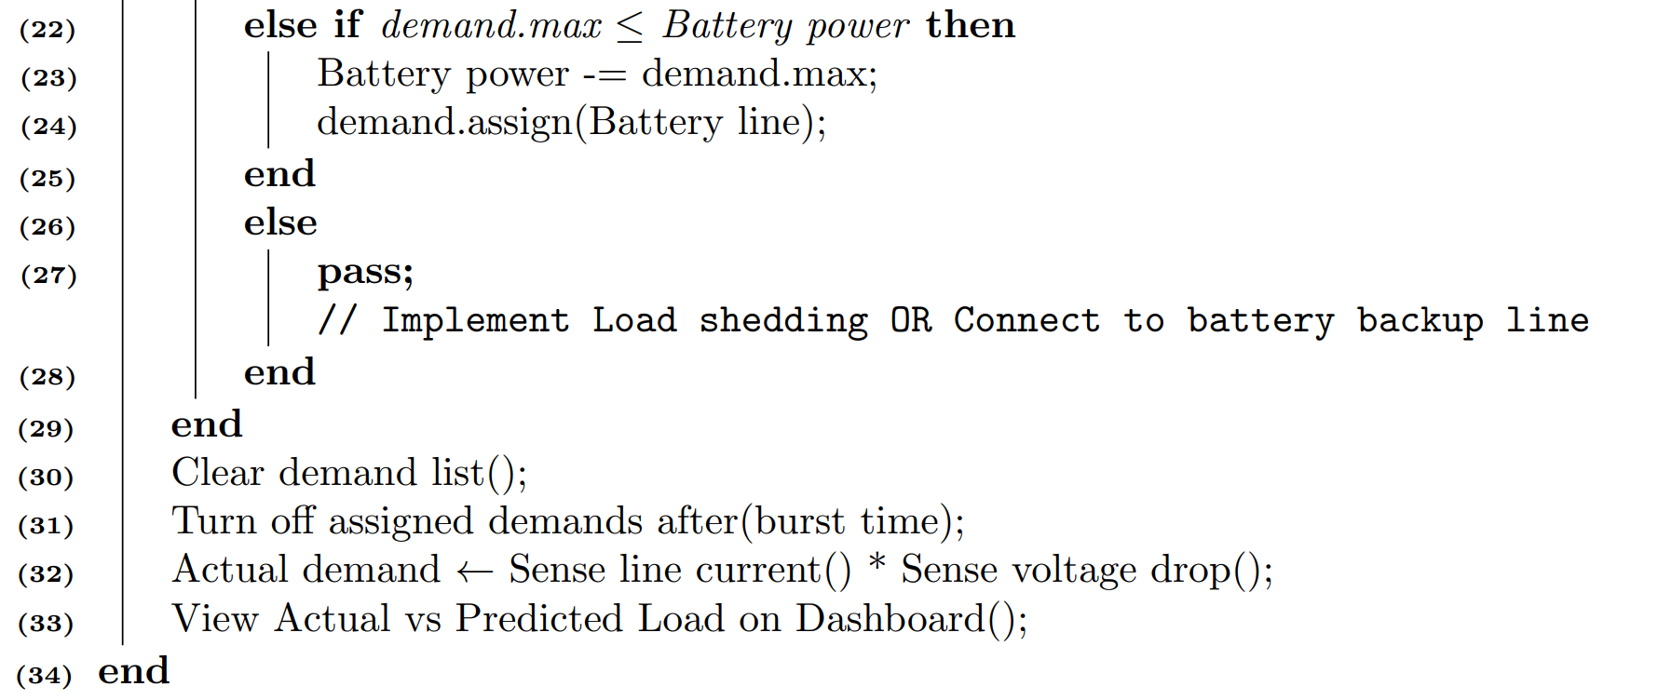
POWER SCHEDULING ALGORITHM

Slide 10
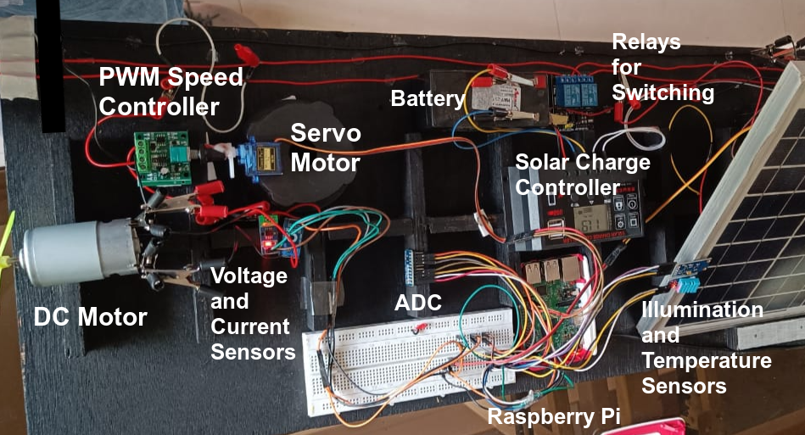
HARDWARE

Slide 11
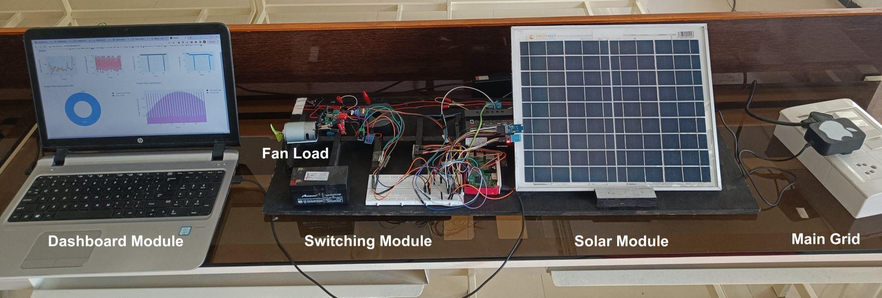
MODULE INTEGRATION

Slide 12
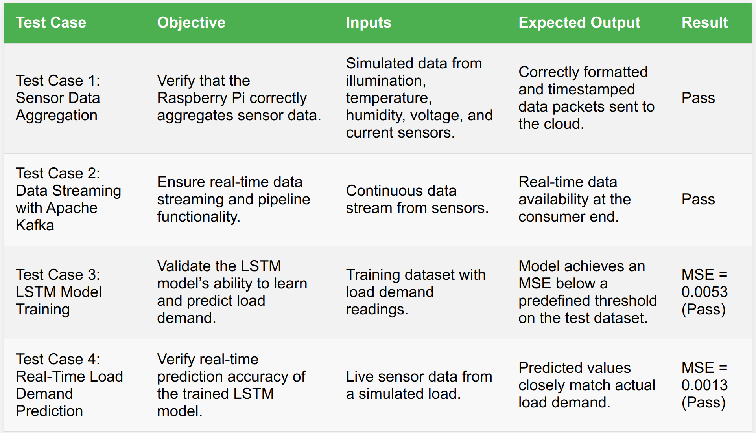
MODULAR TESTING

Slide 13
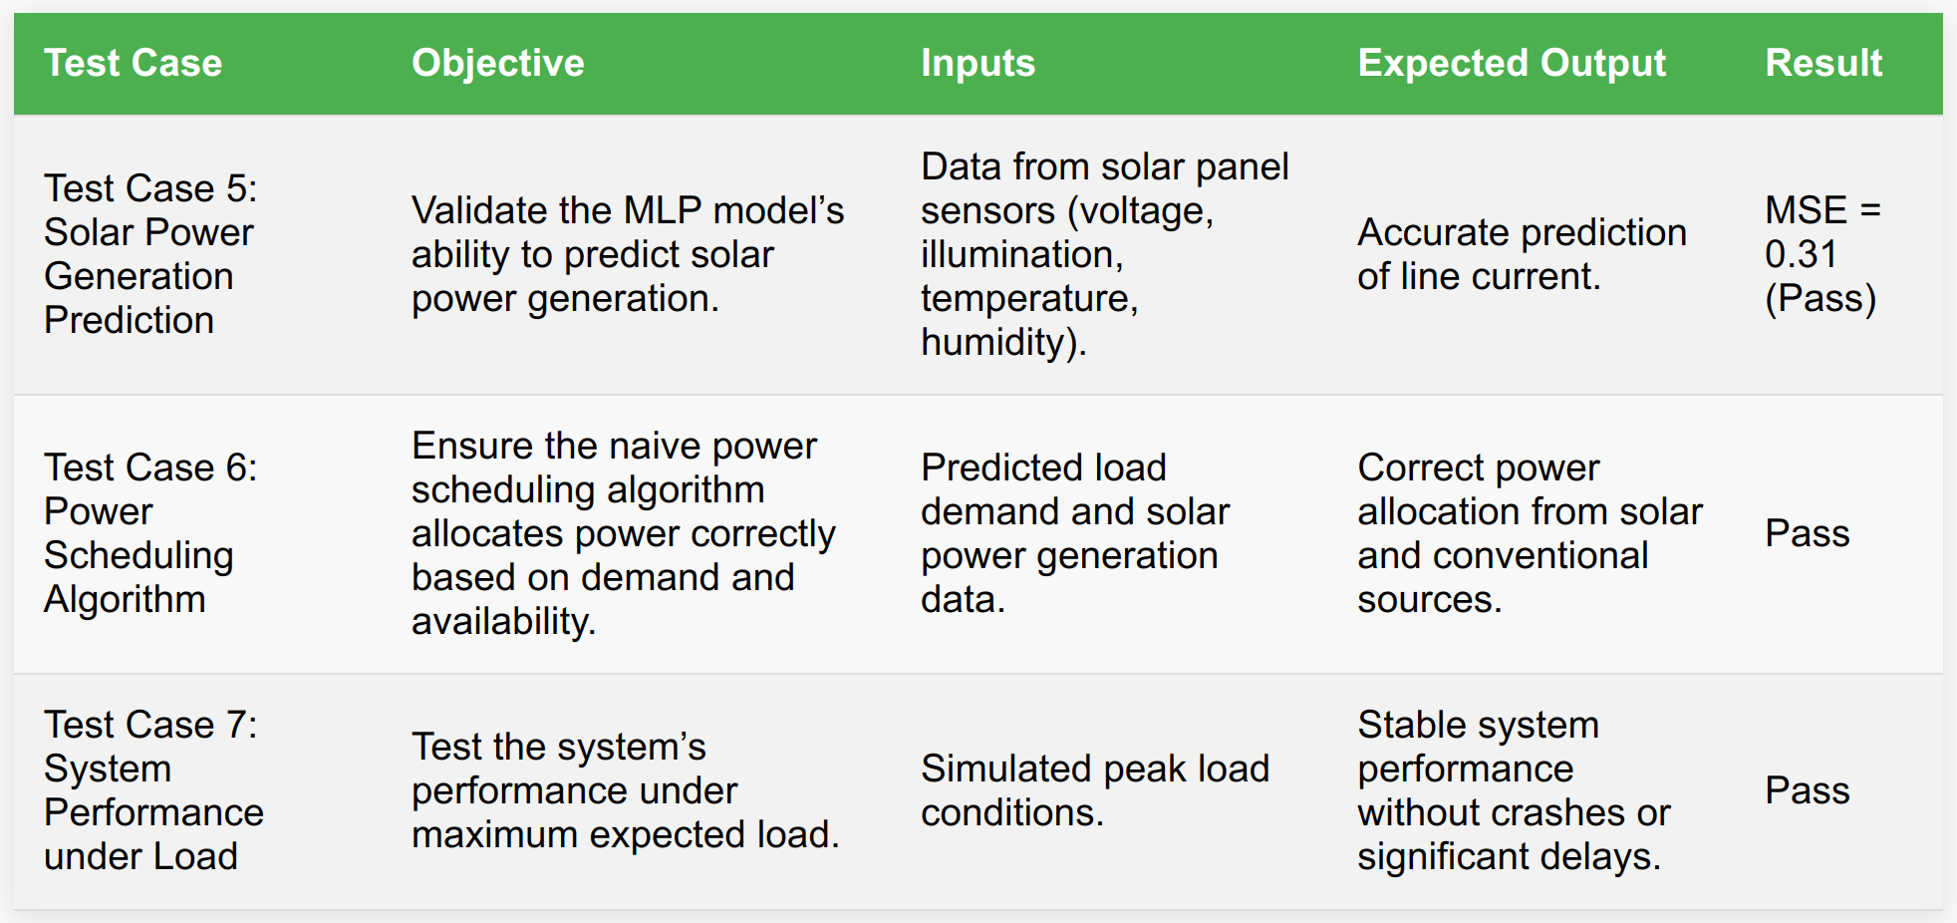
MODULAR TESTING

Slide 14
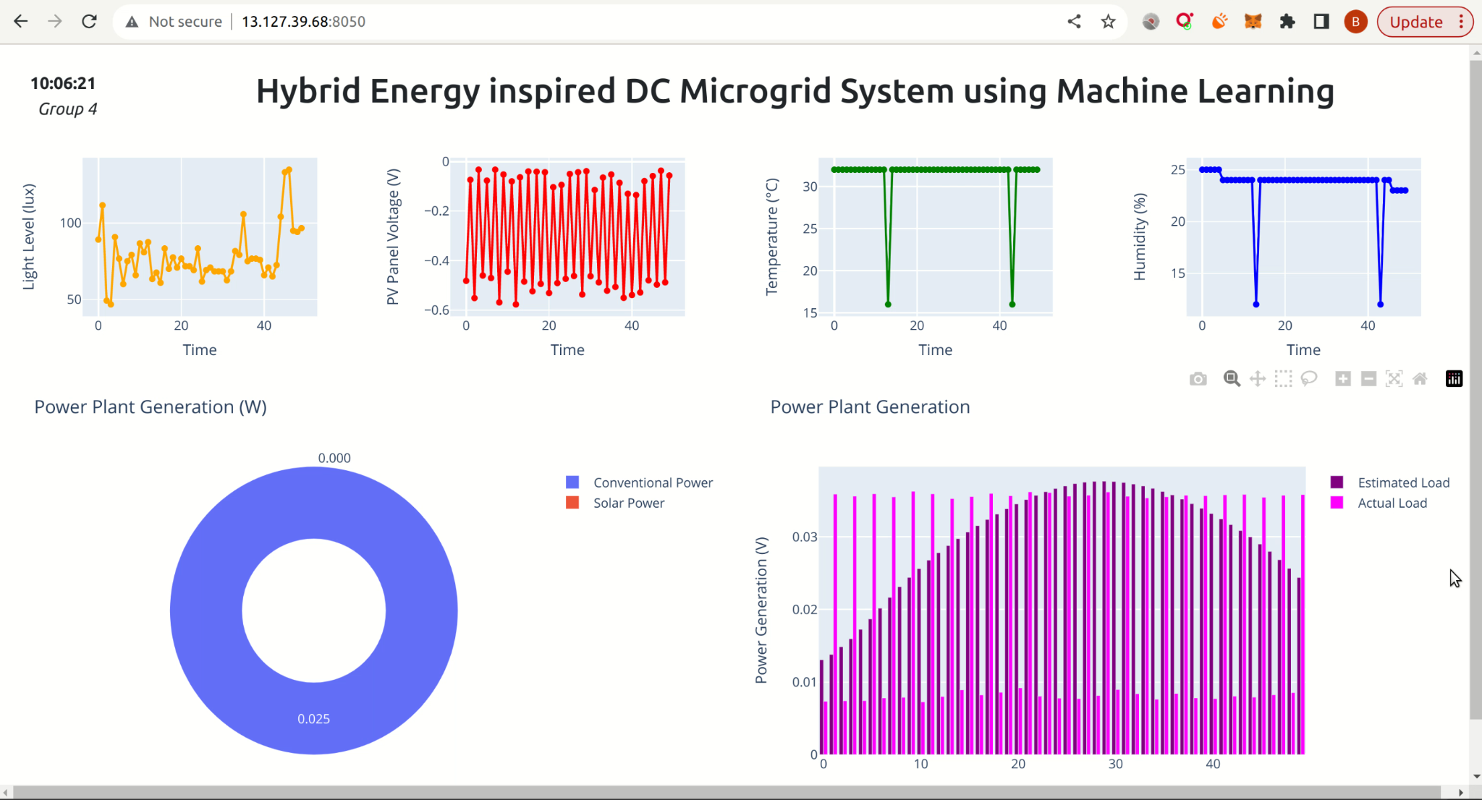
RESULTS

Slide 15
CONCLUSION
We have developed a hybrid energy management system for DC micro-grids, focusing on predicting output power and real-time load demand.
An LSTM model was trained for load demand forecasting, and an MLP was used to estimate solar power generation.
A prototype for a microgrid was implemented, using a naive power scheduling approach based on predicted load and estimated renewable generation to manage conventional power generation.
A real-time dashboard to display the power scheduling information for the Electricity board users was implemented.

Slide 16
FUTURE SCOPE
The current scope is limited to building a wired microgrid setup. If feasible, the next steps would involve developing a wireless microgrid and exploring the security aspects of this wireless smart grid.
This would include executing data manipulation attacks on the wireless communication between the transmitter and receiver, and suggesting possible security measures to counter these attacks.
Additionally, integrating a steam generator and demonstrating the control of thermal output using burner flame controlling knobs would also be considered.

Slide 17
PROJECTED COST AND FEASIBILITY
Hardware Cost : ₹ 8000
Software Development Cost : (COCOMO model)
Effort Estimation (E):
E = a * (KLOC^b) = 3 * (0.8^1.12) ≈ 2.144 person months
Development Time Estimation (D): D = c * (E^d) = 2.5 * (2.144^0.35) ≈ 2.55 months
Cost Estimation (C): C = D*X = 2.55 * 40000 ≈ ₹ 1,02,000 Lakh

Slide 18
REFERENCES
[1] Mostafa M. Shibl, Loay S. Ismail, Ahmed M. Massou (2023) An Intelligent Two-Stage Energy Dispatch Management System for Hybrid Power Plants: Impact of Machine Learning Deployment, https://ieeexplore.ieee.org/document/10038701
[2] Chun-Hung Liu, Jyh-Cherng Gu, Ming-Ta Yang (2021) A Simplified LSTM Neural Networks for One Day-ahead Solar Power Forecasting, https://ieeexplore.ieee.org/document/9333638
[3] Baraa Mohandes, Maisam Wahbah, Mohamed Shawky El Moursi, Tarek H.M. El-Fouly (2021) Renewable Energy Management System: Optimum Design and Hourly Dispatch, https://ieeexplore.ieee.org/document/9351770
[4] Bing Zhu, Henerica Tazvinga, Xiaohua Xia (2014) switched model predictive control for energy dispatching of a photovoltaic diesel battery hybrid power system https://ieeexplore.ieee.org/document/6933909
[5] Team National Smart Grid Mission (2023) Smart Grid Pilot Projects under IPDS (erstwhile RAPDRP Part-C), https://www.nsgm.gov.in/en/sg-pilot
[6] Ankit Gupta (2023) Smart Grid Market Overview, https://www.marketresearchfuture.com/reports/smart-grid-market-1110
[7] Team Wikipedia (2023) Smart Grid, https://en.wikipedia.org/wiki/Smart%20grid
[8] Team SAP (2023) The smart grid: How AI is powering today’s energy technologies — SAP Insights, https://www.sap.com/insights/smart-grid-ai-in-energy-technologies.html
[9] Kamil Talar (2023) Understanding what is Peak Shaving: Techniques and Benefits, https://howtostoreelectricity.com/what-is-peak-shaving
[10] Team IBEF (2023) Power Sector - India, www.ibef.org/industry/power-sector-india.
[11] Stephen Turner, Suleyman Uludag (2015), https://www.researchgate.net/publication/276288597 Towards Smart Cities Interaction and Synergy of the Smart Grid and Intelligent Transportation Systems
[12] Zhenyu Zhuo, ”DATASET-OF-HRP-38-TEST-SYSTEM”, IEEE DataPort, DOI: 10.21227/ggy4-7497, May 17, 2022.

Slide 19
THANK YOU

